Slide 1
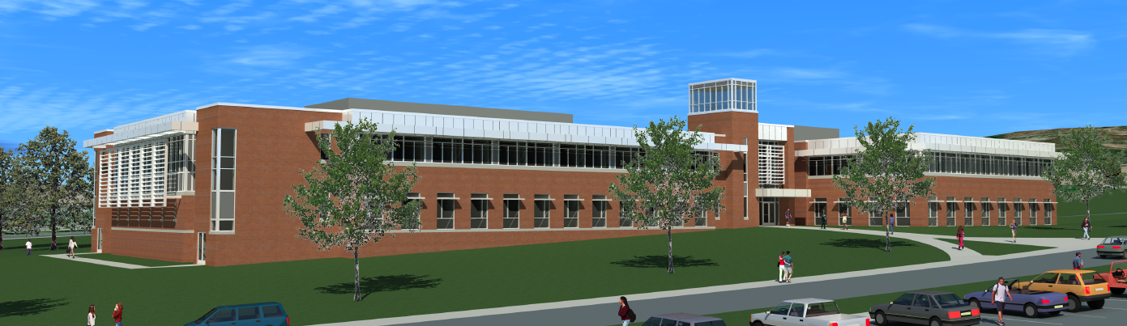
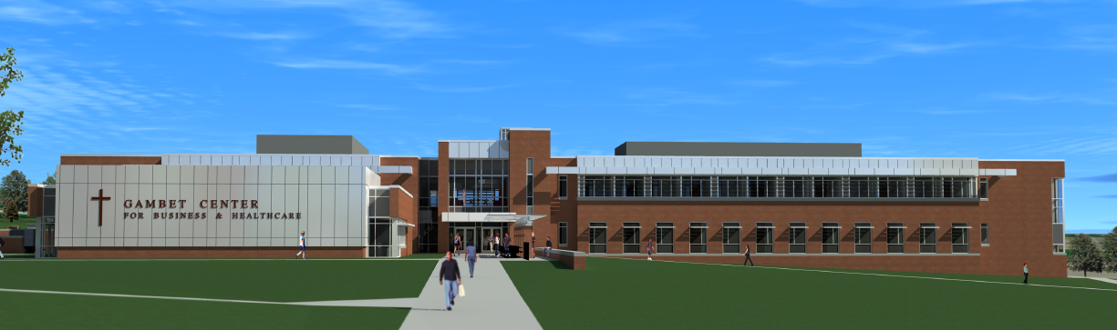
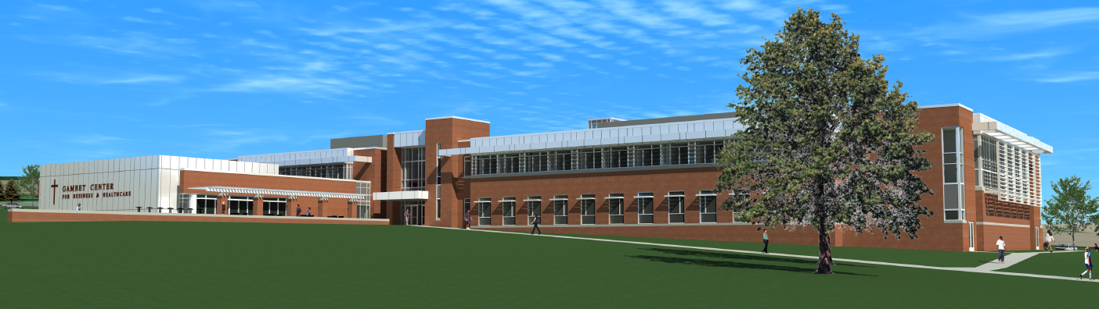
Rev. James G. Gambet Center
DeSales University | Center Valley, PA
Penn State Architectural Engineering Capstone Project
Brett Tallada | Construction Option | Advisor: Ray Sowers

Slide 2
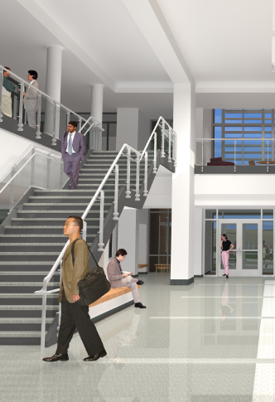


Project Background
Project Overview
  Project Background
  LEED® Evaluation
Conceptual Energy Modeling
Green Roof Implementation
On-Site Renewable Energy
Advanced Lighting Controls
Conclusion
Owner: DeSales University
Architect: Breslin Ridyard Fadero Architects
Construction Manager: Alvin H. Butz, Inc.
Mechanical/Electrical Engineer: Snyder Hoffman Associates
Civil/Structural Engineer: Barry Isett and Associates
New building for Business and Healthcare Education
10 classrooms and lecture hall
Business classrooms with mock trading floor
Cutting edge patient, simulation, and anatomy labs
Faculty and administrative offices
Building Location: DeSales University – Center Valley, PA
Building Size: 77,000 SF
Number of Stories: 2 Stories
Occupancy/Function Type: Business - Offices, Education, Labs
Project Cost: $27 Million
Dates of Construction: June 2011 – February 2013
Project Delivery Method: Design-Bid-Build
ALVIN H. BUTZ, INC.
CONSTRUCTION MANAGER
BRESLIN RIDYARD FADERO ARCHITECTS

Slide 3

LEED® Evaluation
LEED® 2009 Scorecard
Project Overview
  Project Background
  LEED® Evaluation
Conceptual Energy Modeling
Green Roof Implementation
On-Site Renewable Energy
Advanced Lighting Controls
Conclusion
Technical Analyses
Conceptual Energy Modeling
Understand early design implications
Green Roof Implementation
Reduce mechanical load of Lecture Hall
On-Site Renewable Energy
Provide 13% of building’s electricity
Advanced Lighting Controls
Increase energy efficiency
LEED® Category | Credits Earned | Possible Credits
Sustainable Sites | 7 | 26
Water Efficiency | 8 | 10
Energy and Atmosphere | 11 | 35
Materials and Resources | 6 | 14
Indoor Environmental Quality | 10 | 15
Innovation and Design Process | 6 | 6
Regional Priority Credits | 2 | 4
Total (LEED® Silver) | 50 | 110
DeSales focusing more attention to mission of sustainability
Gambet Center to be second LEED® building on campus
Designed for high performance and efficiency
Expected to achieve LEED® Silver rating
Areas for Improvement
15/19 credits available for optimizing energy performance
7 credits available for on-site renewable energy
2 credits available for innovative wastewater technology
1 credit available for use of certified wood

Slide 4
Technical Analysis I
Conceptual Energy Modeling

Slide 5
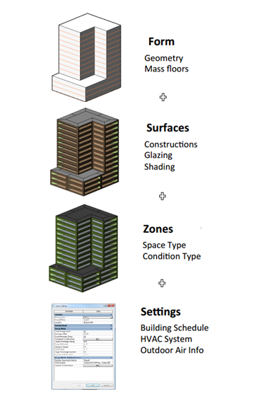

Project Vasari
Steps for Energy Model Analysis
Create or Import Building Model
Set Building Parameters
Run Energy Model Simulation
Analyze Results
Modify Building Variables
Run Additional Simulations
Compare Results
Project Overview
Conceptual Energy Modeling
  Project Vasari
  Energy Analysis
  Results
Green Roof Implementation
On-Site Renewable Energy
Advanced Lighting Controls
Conclusion
Beta software from Autodesk Labs – integrated into Revit 2014
Conceptual energy analysis based on mass model
Used throughout design to compare alternative options
Provides detailed report on annual energy usage
Based on building form, assemblies, function, and systems
Mass Model
Refine Parameters
Run Analysis
Analyze Results
Anatomy of an Energy Model
Images Courtesy of Autodesk

Slide 6
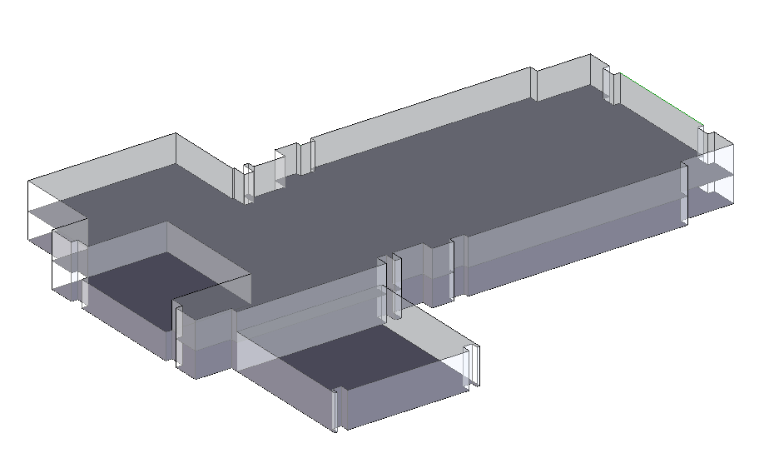
Energy Analysis
Project Overview
Conceptual Energy Modeling
  Project Vasari
  Energy Analysis
  Results
Green Roof Implementation
On-Site Renewable Energy
Advanced Lighting Controls
Conclusion
Original Design Parameters
Location and Orientation | (40.5ºN, 75.4ºW), S19ºW
Function and Operating Schedule | Year-Round University Building
Construction Type | New Construction
Glazing Percentage | 38%
Target Sill Height | 2'-6"
Glazing Shade Depth | 2'-6"
Wall Construction | Standard Construction, High Insulation
Roof Construction | Metal deck with 8" Insulation
HVAC System | High efficiency Packaged Gas VAV
Information Provided from Energy Analysis:
Annual Carbon Emissions
Annual Energy Use/Cost
Fuel and Electricity Consumption
Lifecycle Energy Use
Monthly HVAC Loads
Weather Design Data
Renewable Energy Potential
Mass Energy Model of Gambet Center
Compare effect on annual energy consumption when using a Geothermal Heat Pump

Slide 7
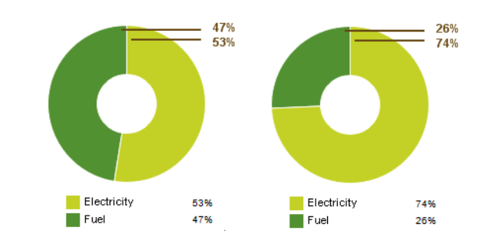
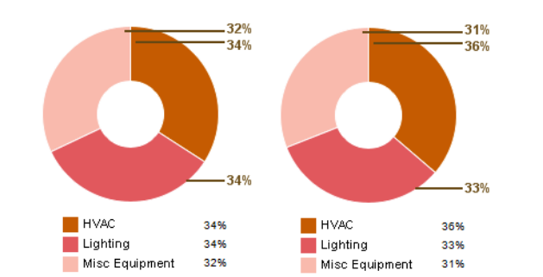
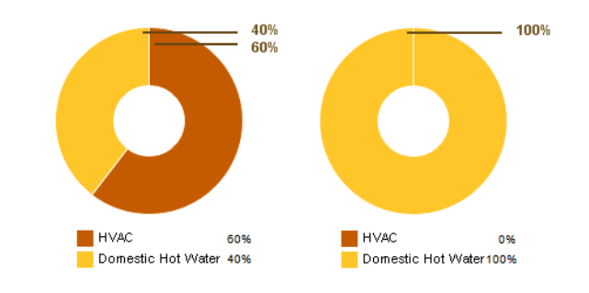
Vasari Results
Implications:
60% reduction in natural gas consumption
Estimated annual fuel savings of $16,257
Project Overview
Conceptual Energy Modeling
  Project Vasari
  Energy Analysis
  Results
Green Roof Implementation
On-Site Renewable Energy
Advanced Lighting Controls
Conclusion
Conclusion
Conceptual energy modeling allows comparative analysis for smarter design choices
Project Vasari is effective at easily calculating changes in energy consumption for various locations, systems, and assemblies
A geothermal heat pump HVAC system increases energy efficiency by 6%, eligible for 3 additional LEED® credits
It is the designer’s responsibility to understand and balance the owner’s goals and budget
Recommendation
The designers of the building can easily use this tool to create a more energy conscious building
If needed, a geothermal heat pump should be installed for the purpose of helping the Gambet Center achieve LEED® Gold.
Annual Electricity Use
Annual Natural Gas Use
Annual Energy Use
Fuel Usage
3.4% increase in whole building power consumption
Electricity Usage
Total annual savings estimated to be $13,434
Optimizes energy efficiency of the building by 6%
Total Energy Usage
Packaged VAV
Heat Pump

Slide 8
Technical Analysis II
Green Roof Implementation

Slide 9
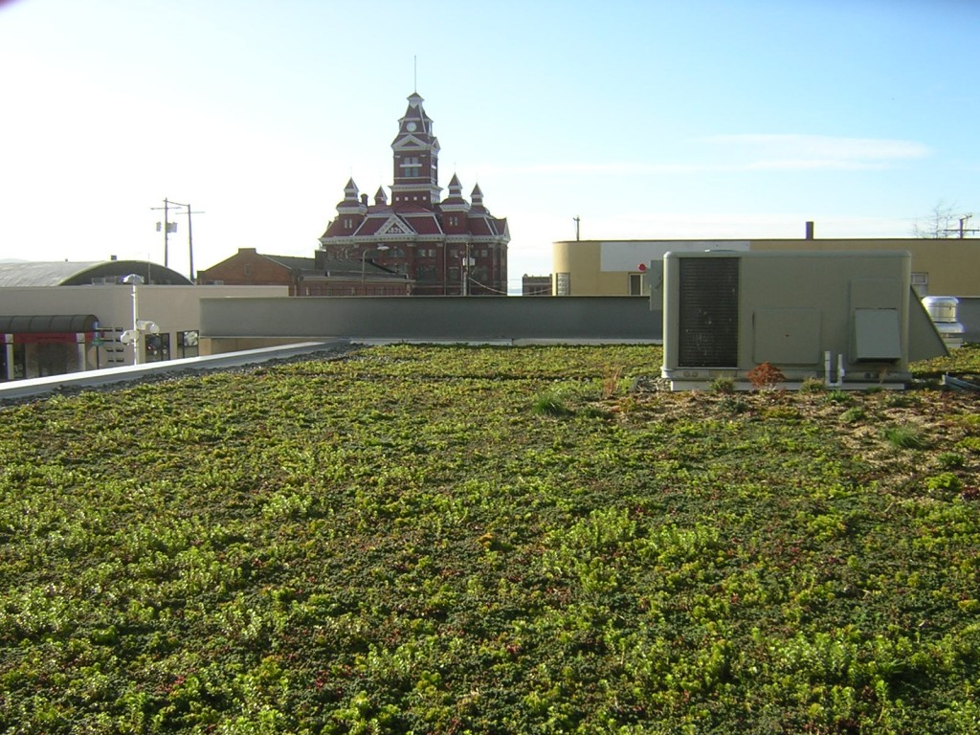
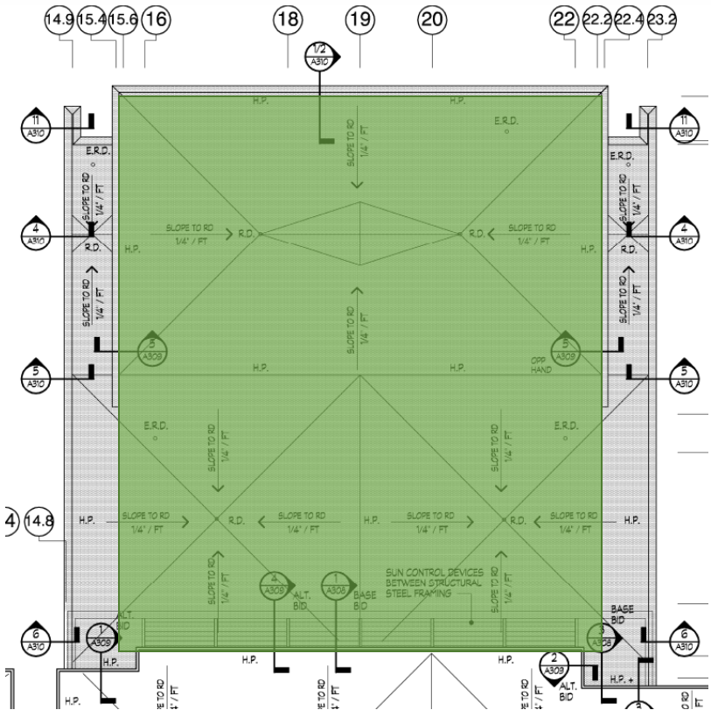
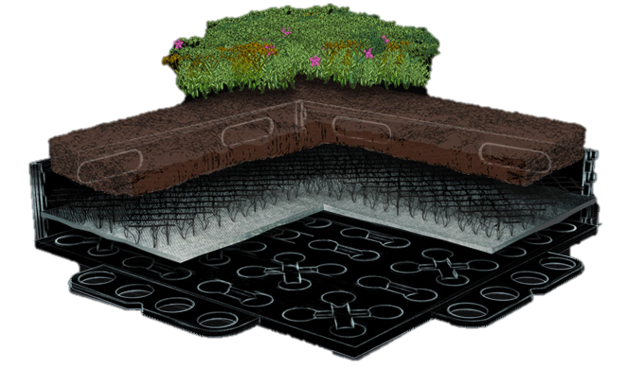
Proposed Design
Project Overview
Conceptual Energy Modeling
Green Roof Implementation
  Proposed Design
  Breadth Analyses
  Lifecycle Cost Analysis
  Recommendation
On-Site Renewable Energy
Advanced Lighting Controls
Conclusion
GroRoofTM Hybrid Green Roof
18” x 18” x 4.5” Modular Green Roof System
Interlocking trays for full soil integration
Instant Vegetation
Dedicated drainage channels
Pre-grown, Extensive Vegetation
Metro-D Lite Engineering Soil
Removable Side Panels
MGV GroMat
Root Stabling and Aeration Mat
5,855 SF Extensive Green Roof Above Lecture Hall
Interlocking Tray Modules

Slide 10
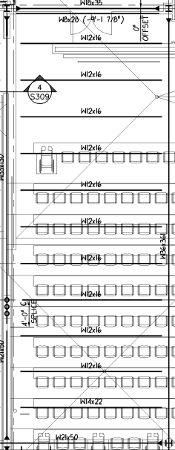
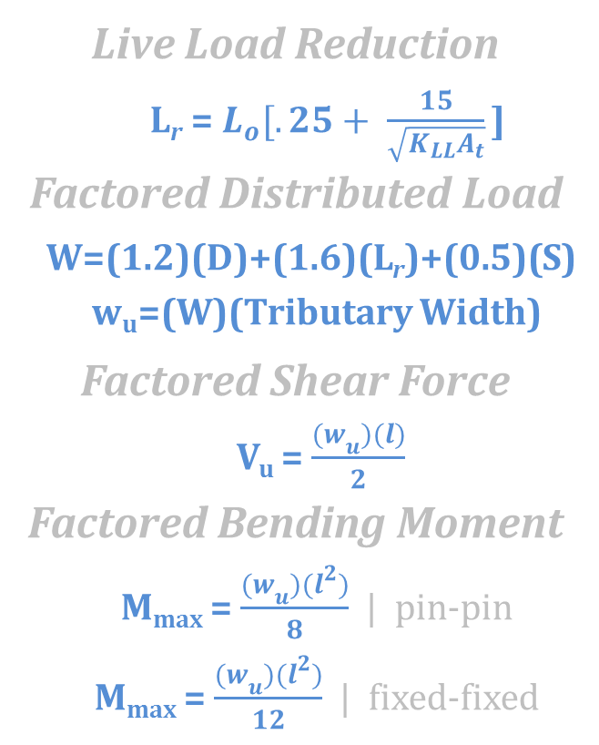
Structural Breadth
Applicable Equations
Project Overview
Conceptual Energy Modeling
Green Roof Implementation
  Proposed Design
  Breadth Analyses
  Lifecycle Cost Analysis
  Recommendation
On-Site Renewable Energy
Advanced Lighting Controls
Conclusion
Steel Members
Girders:
  (1) - 63’-9” W33x130
  (1) - 63’-9” W36x361
Beams: spaced 5’-4” on center
  (10) 23’-10” W12x16
  (1) 23’-10” W14x22
  (1) 23’-10” W18x35
  (1) 23’-10” W21x50
Dead, Live, and Snow Loads
Item | Built-Up Roof | GroRoofTM
Steel Beam Self Weight | 5 psf | 5 psf
Metal Deck | 2 psf | 2 psf
5” Rigid Insulation | 2 psf | 2 psf
M,E,F,P | 15 psf | 15 psf
Ceiling | 2 psf | 2 psf
4 ½” GroRoofTM | - | 32 psf
Total Dead Load | 26 psf | 58 psf
Total Roof Live Load | 20 psf | 20 psf
Total Snow Load | 30 psf | 30 psf
Live Load Reduction
L_{r} = $L_{o}[.25+ \frac{15}{\sqrt{K_{LL}A_{t}}}\text{]}$
Factored Distributed Load
W=(1.2)(D)+(1.6)(L_{r})+(0.5)(S)
w_{u}=(W)(Tributary Width)
Factored Shear Force
  V_{u} = $\frac{{(w}_{u})(l)}{2}$
  Factored Bending Moment
  M_{max} = $\frac{{(w}_{u})(l^{2})}{8}$ | pin-pin
  M_{max} = $\frac{{(w}_{u})(l^{2})}{12}$ | fixed-fixed
Beam and Girder Analysis
 | Shear | Max. Shear | Moment | Max. Moment | Pass/Fail
Beams
W12x16 | 7.44 k | 79.2 k | 44.3 k-ft | 75.4 k-ft | Pass
W14x22 | 7.44 k | 94.9 k | 44.3 k-ft | 125 k-ft | Pass
W18x35 | 7.44 k | 159 k | 29.45 k-ft | 249 k-ft | Pass
W21x50 | 7.44 k | 237 k | 29.45 k-ft | 413 k-ft | Pass
Girders
W33x130 | 31.66 k | 576 k | 378.37 k-ft | 1750 k-ft | Pass
W36x361 | 63.32 k | 1280 k | 756.74 k-ft | 5810 k-ft | Pass
Typical Bay

Slide 11
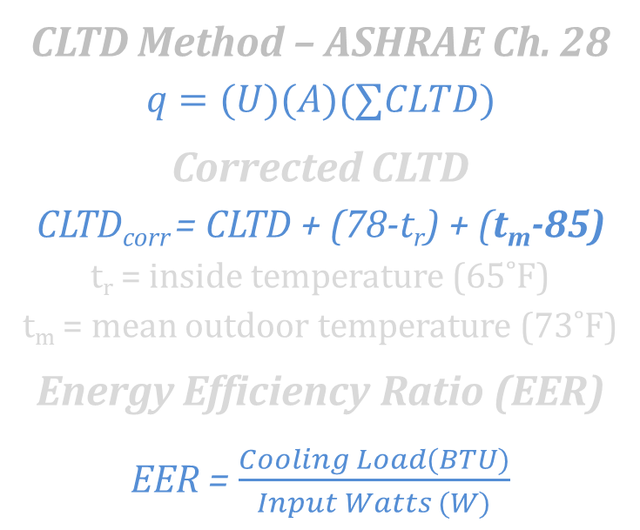
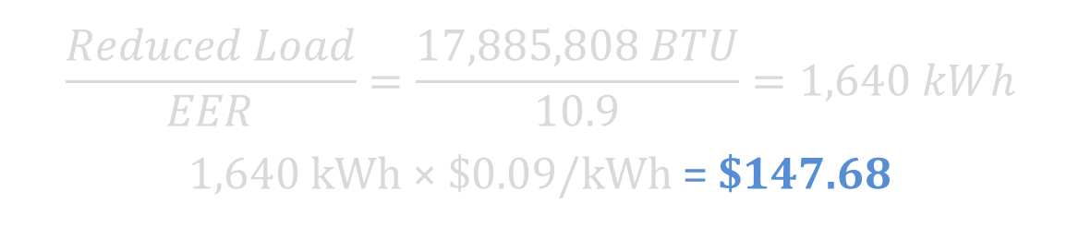
Mechanical Breadth
Applicable Equations
Energy Savings
Project Overview
Conceptual Energy Modeling
Green Roof Implementation
  Proposed Design
  Breadth Analyses
  Lifecycle Cost Analysis
  Recommendation
On-Site Renewable Energy
Advanced Lighting Controls
Conclusion
$$\frac{Reduced Load}{EER}=\frac{17,885,808 BTU}{10.9}=1,640 kWh$$
1,640 kWh × $0.09/kWh = $147.68
CLTD Method – ASHRAE Ch. 28
$$q=(U)(A)(∑CLTD)$$
Corrected CLTD
CLTD_{corr} = CLTD + (78-t_{r}) + (t_{m}-85)
t_{r} = inside temperature (65˚F)
t_{m} = mean outdoor temperature (73˚F)
Energy Efficiency Ratio (EER)
EER = $\frac{Cooling Load(BTU)}{Input Watts (W)}$
Roofing System Component | R-Value
1 ½” Metal Roof Decking | -
5” Rigid Insulation | 20
½” Insulation Cover Board | .85
Single-Ply Asphalt Waterproofing Membrane | .15
GroRoofTM Extensive II Module | 3
Total R-Value (∑R) | 24
U-Value (1/∑R) | .0417
Mechanical Breadth Wrap-Up
Low cost savings implies an unfavorable payback period
CLTD method considers U-Value; excellent thermal performance of original design reduces most solar heat gain on its own
CLTD Method Results
Total Daily Cooling Load in BTU | 194,834
Total Annual Cooling Load in BTU (153 days) | 29,809,677
Green Roof Cooling Load Reduction in BTU (60%) | 17,885,806

Slide 12
Lifecycle Cost Analysis
Project Overview
Conceptual Energy Modeling
Green Roof Implementation
  Proposed Design
  Breadth Analyses
  Lifecycle Cost Analysis
  Recommendation
On-Site Renewable Energy
Advanced Lighting Controls
Conclusion
Up-Front Cost Estimate
4.5” GroRoof Installed Cost per SF: $19.00
GroRoof Area: 5,855 SF
Total Up-Front Cost: $111,245
Payback Period
25 Years
Return on Investment
$22,263 (20%)
Energy Savings
$147.86 per year
Increased Lifespan Savings
$77,688 in the 25th year
Tax Incentive Savings
$50,000 over first 6 years
*Contingent upon the passing of proposed legislation

Slide 13



Recommendation
Project Overview
Conceptual Energy Modeling
Green Roof Implementation
  Proposed Design
  Breadth Analyses
  Lifecycle Cost Analysis
  Recommendation
On-Site Renewable Energy
Advanced Lighting Controls
Conclusion
Not Recommended
Small ROI and unfavorable payback period
Low energy savings
No affect to LEED®
Recommended – If Legislation Passes
Saves owner from replacing roof in 25 years
Depends on if owner is willing to invest
Investment could profit owner approx. $20,000 by increasing lifespan
Conclusion:
Although a 20% ROI, the goal of this analysis was to increase energy efficiency
The energy savings are negligible and will not affect LEED® score
Owner has two options
Final Recommendation

Slide 14
Technical Analysis III
On-Site Renewable Energy

Slide 15
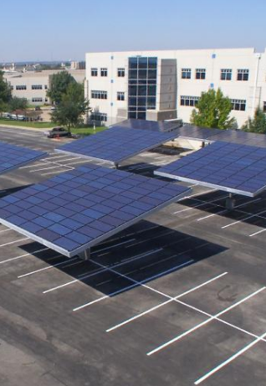
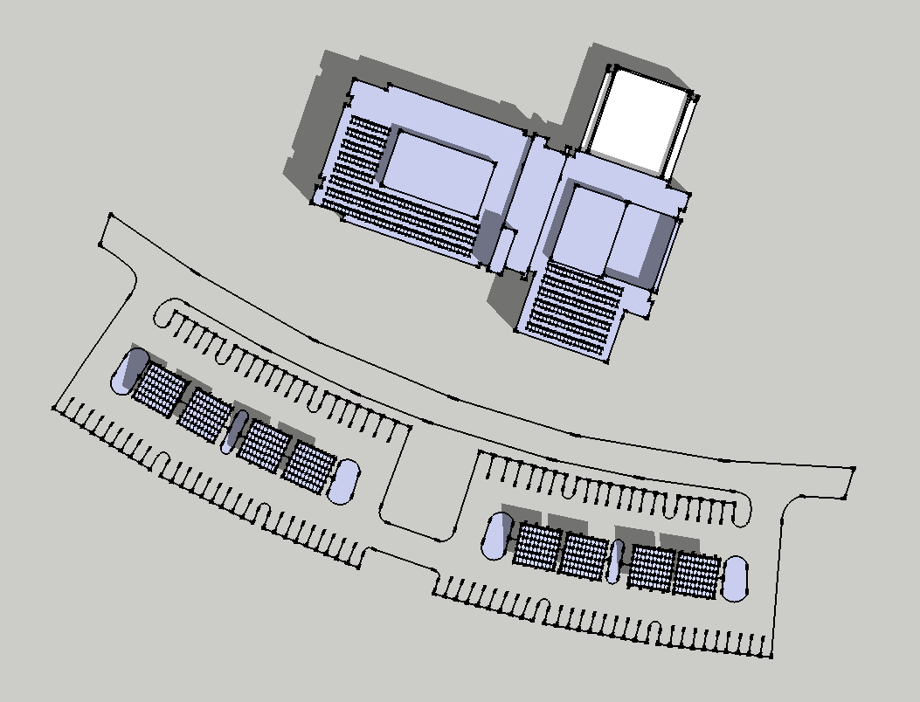
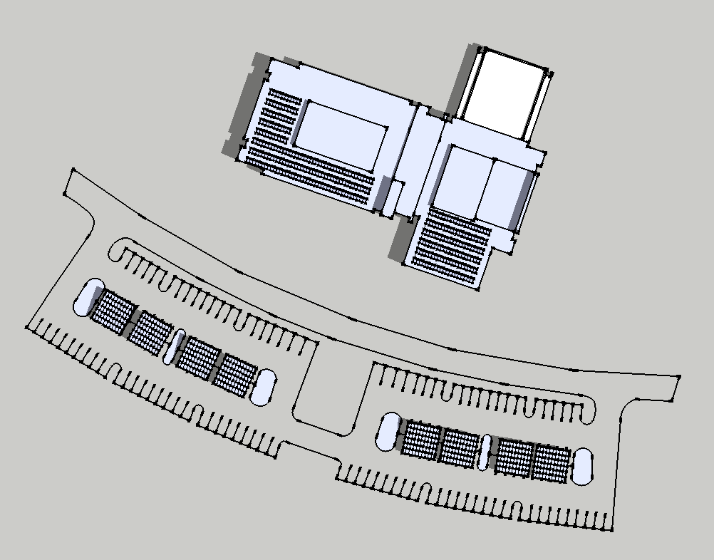
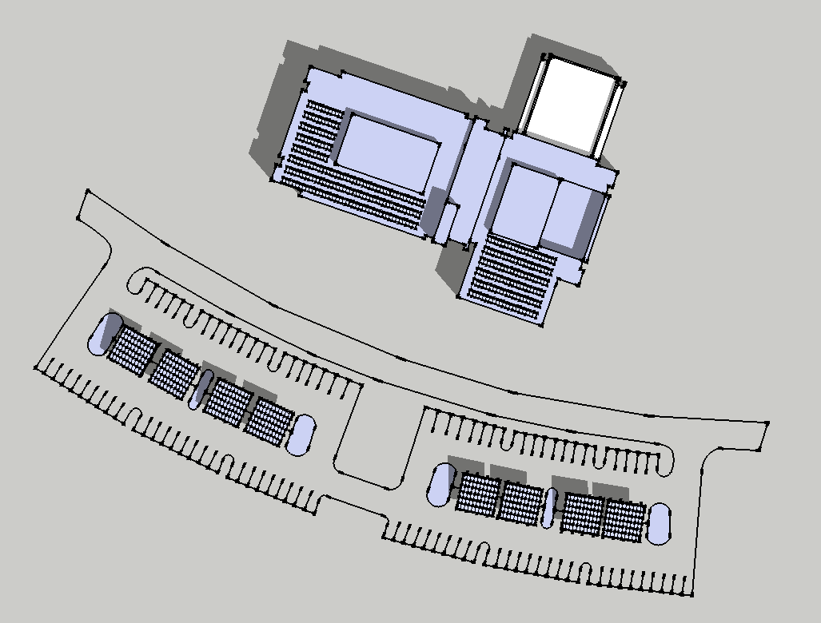
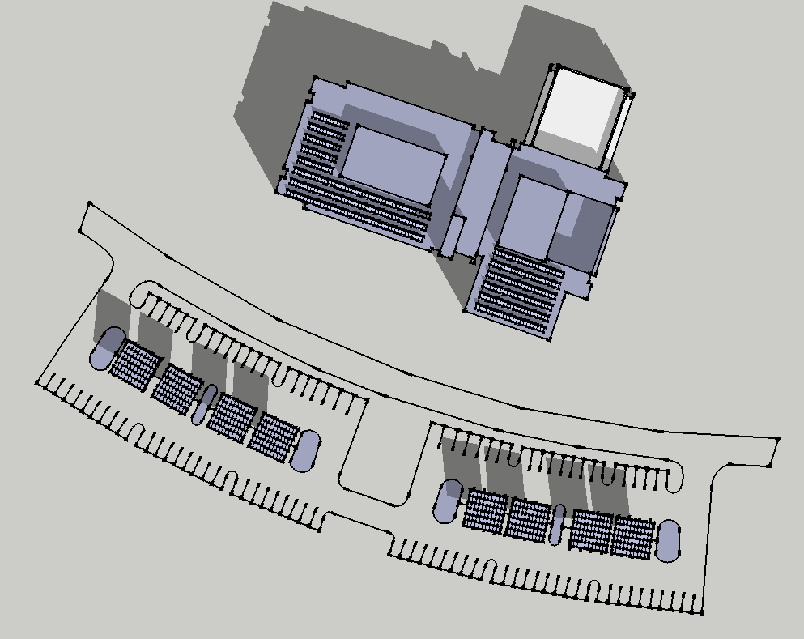
Proposed Design
MARCH 21
JUNE 21
Project Overview
Conceptual Energy Modeling
Green Roof Implementation
On-Site Renewable Energy
  Proposed Design
  Generation Capacity
  Lifecycle Cost Analysis
  Recommendation
Advanced Lighting Controls
Conclusion
Rooftop Array
(310) 250W Astronenergy NOVA Solar Panels
77,500 Wdc generation capacity
SatCon Powergate Plus 100 kW Inverter
33.5º panel tilt; 6’ -1.5” row spacing
Envision® Solar Tree Parking Canopy
(8) 14.4 kW Solar Tree Structures in parking lot
115,200 Wdc generation capacity
SatCon Powergate Plus 130 kW Inverter
SEPTEMBER 21
DECEMBER 21
Solar Shading Study (12 pm)

Slide 16

Generation Capacity
PVWattsTM Results
 | Monthly AC Energy Generated (kWh)
Month | Roof | Parking 1 | Parking 2 | Parking 3 | Parking 4 | Total
1 | 5737 | 1737 | 1731 | 1686 | 1662 | 12,553
2 | 6273 | 2068 | 2063 | 2032 | 2016 | 14,452
3 | 8554 | 2993 | 2989 | 2956 | 2939 | 20,431
4 | 9230 | 3413 | 3412 | 3400 | 3391 | 22,846
5 | 9230 | 3605 | 3604 | 3588 | 3581 | 23,608
6 | 8816 | 3540 | 3538 | 3524 | 3517 | 22,935
7 | 9540 | 3743 | 3740 | 3725 | 3720 | 24,468
8 | 8856 | 3338 | 3337 | 3324 | 3317 | 22,172
9 | 7924 | 2828 | 2826 | 2807 | 2797 | 19,182
10 | 7358 | 2434 | 2430 | 2389 | 2368 | 16,979
11 | 4781 | 1514 | 1510 | 1481 | 1467 | 10,753
12 | 4829 | 1451 | 1446 | 1405 | 1384 | 10,515
Annual Electricity Generation (kWh) |  |  |  |  |  | 220,894
Annual Cost Savings at $0.09/kWh |  |  |  |  |  | $ 21,205.82
Project Overview
Conceptual Energy Modeling
Green Roof Implementation
On-Site Renewable Energy
  Proposed Design
  Generation Capacity
  Lifecycle Cost Analysis
  Recommendation
Advanced Lighting Controls
Conclusion
Annual Power Generation
220,894 kWh
Building Annual Power Use
781,313 kWh
Renewable Percentage
28%
Annual Cost Savings
$21,206
PVWattsTM Input Parameters
City | Allentown
State | Pennsylvania
Latitude | 40.65º N
Longitude | 75.43º W
Elevation | 117 m
PV System Specifications |  | Roof | Parking 1 | Parking 2 | Parking 3 | Parking 4
DC Rating (kW) |  | 77.5 | 28.8 | 28.8 | 28.8 | 28.8
DC to AC Derate Factor |  | 0.77 | 0.77 | 0.77 | 0.77 | 0.77
AC Rating (kW) |  | 59.7 | 22.2 | 22.2 | 22.2 | 22.2
Array Type |  | Fixed Tilt | Fixed Tilt | Fixed Tilt | Fixed Tilt | Fixed Tilt
Array Tilt |  | 33.5º | 15º | 15º | 15º | 15º
Array Azimuth |  | 199º | 189º | 192º | 205º | 209º

Slide 17
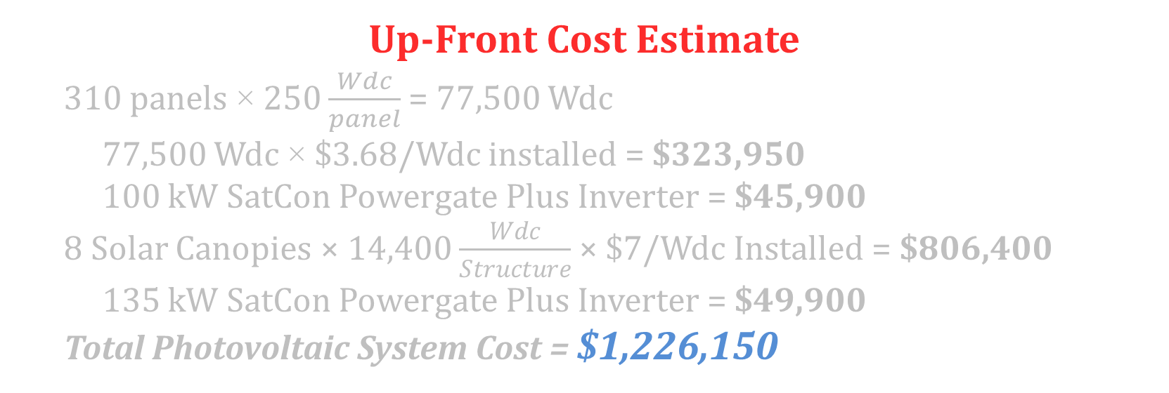
Lifecycle Cost Analysis
Up-Front Cost Estimate
  310 panels × 250 $\frac{Wdc}{panel}$ = 77,500 Wdc
  77,500 Wdc × $3.68/Wdc installed = $323,950
  100 kW SatCon Powergate Plus Inverter = $45,900
  8 Solar Canopies × 14,400 $\frac{Wdc}{Structure}$ × $7/Wdc Installed = $806,400
  135 kW SatCon Powergate Plus Inverter = $49,900
  Total Photovoltaic System Cost = $1,226,150
Project Overview
Conceptual Energy Modeling
Green Roof Implementation
On-Site Renewable Energy
  Proposed Design
  Generation Capacity
  Lifecycle Cost Analysis
  Recommendation
Advanced Lighting Controls
Conclusion
Annual Cost Savings
$21,206 per year
ITC Tax Incentive (30%)
$367,845 after first year
SREC ($180/MWh)
$39,840/year for 10 years
Pay Back Period
23 years
Return on Investment
$70,246 (5.7%)

Slide 18
Recommendation
Project Overview
Conceptual Energy Modeling
Green Roof Implementation
On-Site Renewable Energy
  Proposed Design
  Generation Capacity
  Lifecycle Cost Analysis
  Recommendation
Advanced Lighting Controls
Conclusion
Conclusions
The proposed system is easily eligible for 7 LEED® credits for providing over 13% of Gambet Center’s electricity
The long payback period and low ROI make the option undesirable to the owner
Premium price of Envision® Solar Tree offsets the future savings
Revised Design
Rooftop array with one Solar Canopy
Generates 15.7% - 7 LEED® credits
Reduces payback period to 15 years
$105,000 ROI (21%)
Final Recommendation

Slide 19
Technical Analysis IV
Advanced Lighting Control

Slide 20
Quantum® Upgrade
Upgrade Summary
80 Keypads, 76 Occupancy Sensors and 65 Daylight Sensors for perimeter faculty offices
198 EcoSystem® Compatible Fixtures
Insufficient system capacity
Upgrading to more advanced Hubs significantly increases cost
Project Overview
Conceptual Energy Modeling
Green Roof Implementation
On-Site Renewable Energy
Advanced Lighting Controls
  Quantum® Upgrade
  Energy Savings
  Lifecycle Cost Analysis
  Recommendation
Conclusion
HUB 1
System Capacity Summary
 | Used | Avail. | Req'd
EcoSystem® | 18 | 110 | 198
Loop 1 | 18 | 46 | -
Loop 2 | 0 | 64 | -
QS Devices | 261 | 36 | 110
Link 1-A | 94 | 5 | -
Link 1-B | Panel Link
Link 2-A | 75 | 24 | -
Link 2-B | 92 | 7 | -
QS Links
Wall Keypads
Sensor Modules
EcoSystem® Loops
Fixture/AV Interfaces
Wireless Option
Maximizes system limitation
29 Existing sensor modules provide enough RF range for wireless inputs
Wireless devices are less expensive
2 additional EcoSystem® loops added to QS Link
EcoSystem® Loop
99 QS Devices per Link
64 Eco Devices per Loop

Slide 21
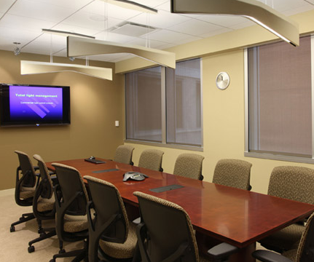
Energy Savings
Luminaire Takeoff
Complete quantity takeoff of luminaires
Assumes 10 hours per day
Considers Lutron’s approximations for energy savings
Calculated lighting loads for no control system, the original Quantum® system, and the proposed wireless upgrade
Project Overview
Conceptual Energy Modeling
Green Roof Implementation
On-Site Renewable Energy
Advanced Lighting Controls
  Quantum® Upgrade
  Energy Savings
  Lifecycle Cost Analysis
  Recommendation
Conclusion
Lighting Load Summary
Baseline Lighting Load | 216,500 kWh
Current Energy Savings | 27,212 kWh
Current Lighting Load | 189,287 kWh
Upgraded Energy Savings | 14,878 kWh
Upgraded Lighting Load | 174,409 kWh
Increase in Energy Efficiency
Current Design over Baseline | 13%
Upgraded Fixtures over Baseline | 34%
Upgraded Design over Current Load | 8%
Total Savings over Baseline | 19%
Annual Cost Savings
$1,330 per year
Improves Bldg. Efficiency
1% (No LEED® points)
Energy Savings per Control Strategy
Personal Dimming | 10%
Occupancy Sensing | 15%
Daylight Harvesting | 15%

Slide 22
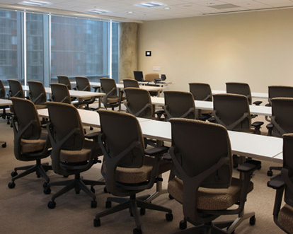
Lifecycle Cost Analysis
Additional Cost of Upgrade
Exact price information not revealed, as requested by Lutron®
Considers additional equipment, one day of field start up, and deducts the cost of the original equipment
Project Overview
Conceptual Energy Modeling
Green Roof Implementation
On-Site Renewable Energy
Advanced Lighting Controls
  Quantum® Upgrade
  Energy Savings
  Lifecycle Cost Analysis
  Recommendation
Conclusion
Annual Cost Savings
$1,330
System Lifetime
15 years
Payback Period
5 years
Return on Investment
$13,471 (203%)

Slide 23
Recommendation
Project Overview
Conceptual Energy Modeling
Green Roof Implementation
On-Site Renewable Energy
Advanced Lighting Controls
  Quantum® Upgrade
  Energy Savings
  Lifecycle Cost Analysis
  Recommendation
Conclusion
Conclusions
6% more efficient than current design
Upgrade does not affect LEED® score
Very favorable payback period and ROI
Although no change to LEED® score, upgraded system should be added to the project
Final Recommendation

Slide 24
Conclusion

Slide 25
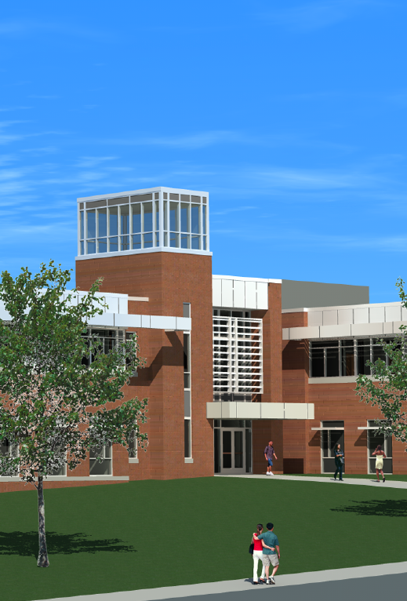
Analysis Summary
Project Overview
Conceptual Energy Modeling
Green Roof Implementation
On-Site Renewable Energy
Advanced Lighting Controls
Conclusion
  Analysis Summary
  Other Considerations
Goal: Achieve LEED® Gold rating
Goal: Acceptable payback period and return on investment
Recommendations
 | Point Gain | YES | NO
Green Roof Implementation | 0 |  | û
Photovoltaic System | 7 | ü
Upgraded Light Controls | 0 |  | û
Goal Achieved |  |  | û
 | YES | NO
Green Roof Implementation | ü | û
Photovoltaic System | ü
Upgraded Light Controls | ü
Goal Achieved | ü

Slide 26
Other Considerations
Project Overview
Conceptual Energy Modeling
Green Roof Implementation
On-Site Renewable Energy
Advanced Lighting Controls
Conclusion
  Analysis Summary
  Other Considerations
Goal: Achieve LEED® Gold rating
Certified Wood – 1 credit
  50% of wood certified by Forest Stewardship Council
Innovative Wastewater Technology – 2 credits
  Substitute 50% of waste water with rainwater harvesting system
  10,000 gallon system costs $140,000-$200,000
Optimize Energy Performance – +3 credits
  Heat pump HVAC system considered in Tech I
  Improves building efficiency by 6 percent
  $584,000 cost increase over VAV system
Recommendations
 | Point Gain | YES | NO
Green Roof Implementation | 0 |  | û
Photovoltaic System | 7 | ü
Upgraded Light Controls | 0 |  | û
Goal Achieved |  |  | û

Slide 27
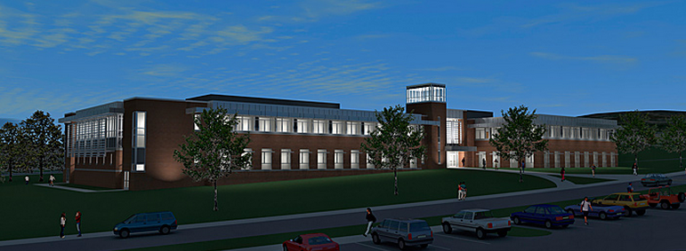
Acknowledgements
Advisor: Ray Sowers
Moses Ling
AE Faculty
DeSales University
Breslin Ridyard Fadero Architects
Alvin H. Butz, Inc.
Lutron Electronics Co., Inc.
MGV GroRoof
Family and Friends
Thank You

Slide 28
References
¹Allen, Carolyn. “Solar Trees in Parking Lots.” http://www.californiagreensolutions.com/cgi-bin/gt/tpl.h,content=2180
²ASHRAE, (1997), ASHRAE Handbook-Fundamentals, Atlanta, American Society of Heating, Refrigerating and Air-Conditioning Engineers, Inc.
³“Green Roof Legislation, Policies, and Tax Incentives.” Plant Connection, Inc, 2013. http://www.myplantconnection.com/green-roofs-legislation.php
⁴Gronbeck, Christopher. Panel Shading Calculator. 2009. http://www.susdesign.com/panel_shading/index.php
⁵GroRoofTM. http://www.mgvgroroof.com
⁶“History of Greenroofs.” Lawrence Technological University. http://www.ltu.edu/water/greenroofs_history.asp
⁷IESNA 2000 Proceedings, Paper #34: Occupant Use of Manual Lighting Controls in Private Ofﬁces. “Giving the occupant manual switching and dimming provided a total of 15% added savings above the 43% achieved by motion sensors.
⁸IESNA 2000 Proceedings, Paper #43: An analysis of the energy and cost savings potential of occupancy sensors for commercial lighting systems. ”Occupancy sensor savings range from 17% to 60% depending upon space type and time delay settings.”
⁹Kelly, Jim. Photovoltaic Array Installer. (2013, February 28). Phone Interview.
¹⁰Landau, Charles R. “Optimum Tilt of Solar Panels.” 2012. http://www.macslab.com/optsolar.html
¹¹LiveRoof®. http://www.liveroof.com
¹²Lutron Electronics Company, Inc. http://www.lutron.com
¹³SatCon Powergate Plus 100kW Inverter. http://www.solarpanelsonline.org/SatCon-Powergate-Plus-100kW-inverter-480V-p/171055.htm
¹⁴SatCon Powergate Plus 135kW Inverter. http://www.solarpanelsonline.org/SatCon-Powergate-Plus-135kW-inverter-p/171053.htm
¹⁵Snodgrass and McIntyre. The Green Roof Manual. Timber Press, 2010.
¹⁶“Solar Energy 101: Introduction to Solar Energy.” Dow Corning. http://www.dowcorning.com/content/solar/solarworld/solar101.aspx
¹⁷SREC Pricing. PA AEPS Alternative Energy Credit Program. http://paaeps.com/credit/pricing.do
¹⁸“Total Light Management.” Lutron Electronics Company, Inc, 2011. http://www.lutron.com/TechnicalDocumentLibrary/3671737b_tlm_sp.pdf
¹⁹US Department of Energy. How to Select Lighting Controls for Ofﬁces and Public Buildings. Claim: 27% potential savings using daylight harvesting.
²⁰Walsh, Tom. LiveRoof® Installer. (2013, February 6). Phone Interview.
²¹Williams, Zach. GroRoofTM Director of Tech Sales. (2013, February 12). Phone Interview.
²²Zeman, Miro. “Introduction to Photovoltaic Solar Energy.” Delft University of Technology. http://ocw.tudelft.nl/fileadmin/ocw/courses/SolarCells/res00025/CH1_Introduction_to_PV_solar_energy.pdf
²³Shirian, Abbas. “Life Cycle Cost.” Bridgers & Paxton Conulting Engineers, Inc. https://www.google.com/url?sa=t&rct=j&q=&esrc=s&source=web&cd=4&cad=rja&ved=0CEwQFjAD&url=http%3A%2F%2Fwww.emnrd.state.nm.us%2Fecmd%2FMultimedia%2Fdocuments%2FLifeCycleCost.ppt&ei=4JxaUdruENTh4APKroGYAw&usg=AFQjCNE2UV7_SVBkZWpXtG6DuA2FJfxGRg

